Slide 1
Food Saver
Brian Franklin, Dang Truong, Elijah Tate, and Prahalad Muralidharan

Slide 2
Purpose of our Application
The Food Saver application creates a platform for registered food providers to sell their soon to expire food at a low cost
It will provide consumers with a list of items on sale and the address of the store that contains the item

Slide 3
Technical Platform
Using an android application, our food saver app will show customers food items, along with their price, expiration date, and location, that are stored in a SQL database.
On a webpage, food suppliers will be able to access the database to enter food items, as well as corresponding information such as the price, product information, expiration date, and their store address

Slide 4
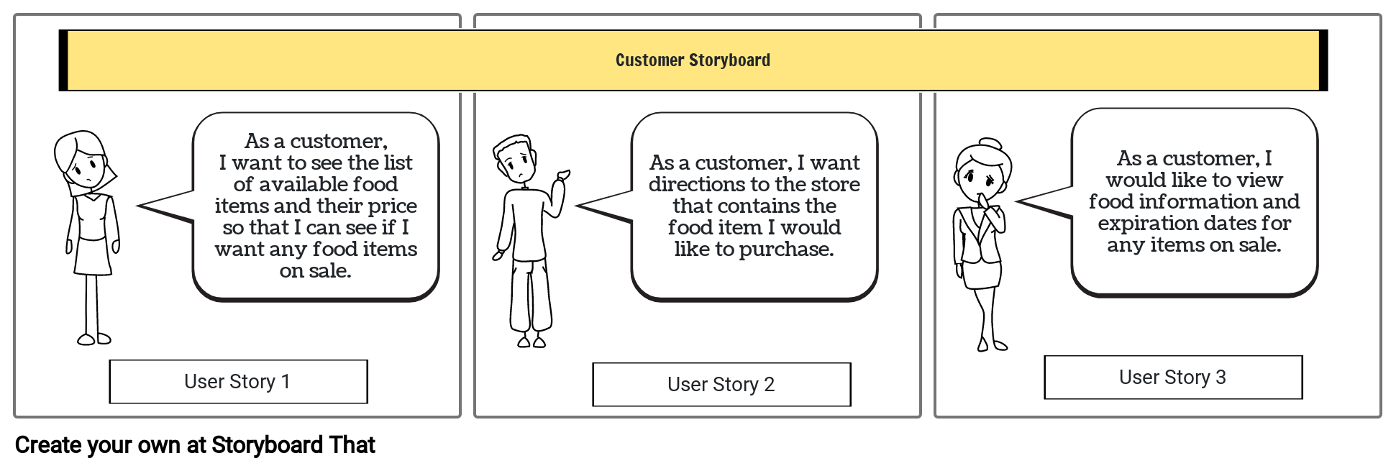
Customer Storyboard

Slide 5
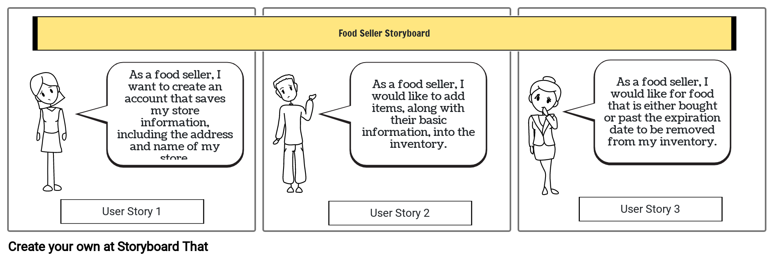
Food Seller Storyboard

